Slide 1
This is a simple portal how it looks like enclosed in the first slide
On the left side a few main options provided as functional requirements like
Content
Web Content
Documents
Media
Blogs
Bookmarks
Message Boards
Dynamic Data Lists
Forms
Tags
===============================================================
Documents and Media are separate options:
when i click Documents it is nice to take it to similar to slide no 3.
It should provide to create multiple folders
likewise media.
Under folders to upload documents pdf, doc, html and so on
Under media MP3 and MP4 files to be uploaded options.

Slide 2
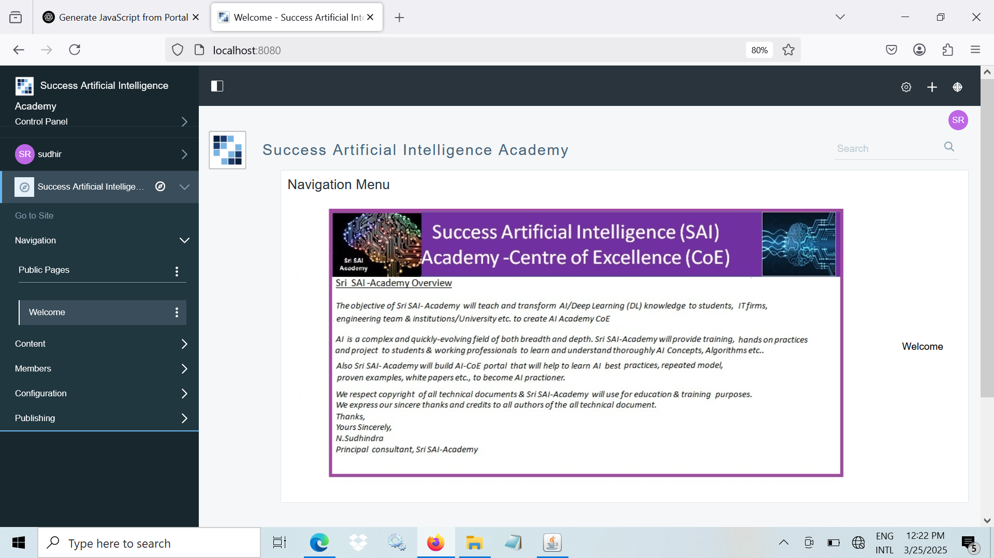

Slide 3
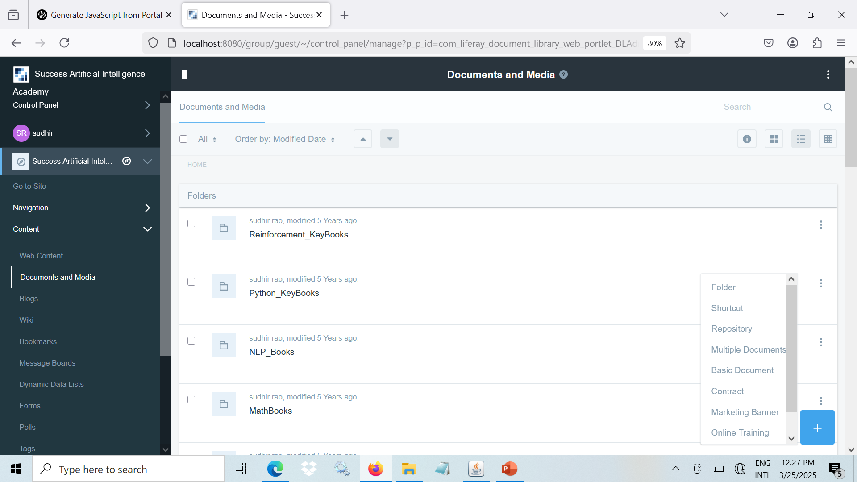

Slide 4
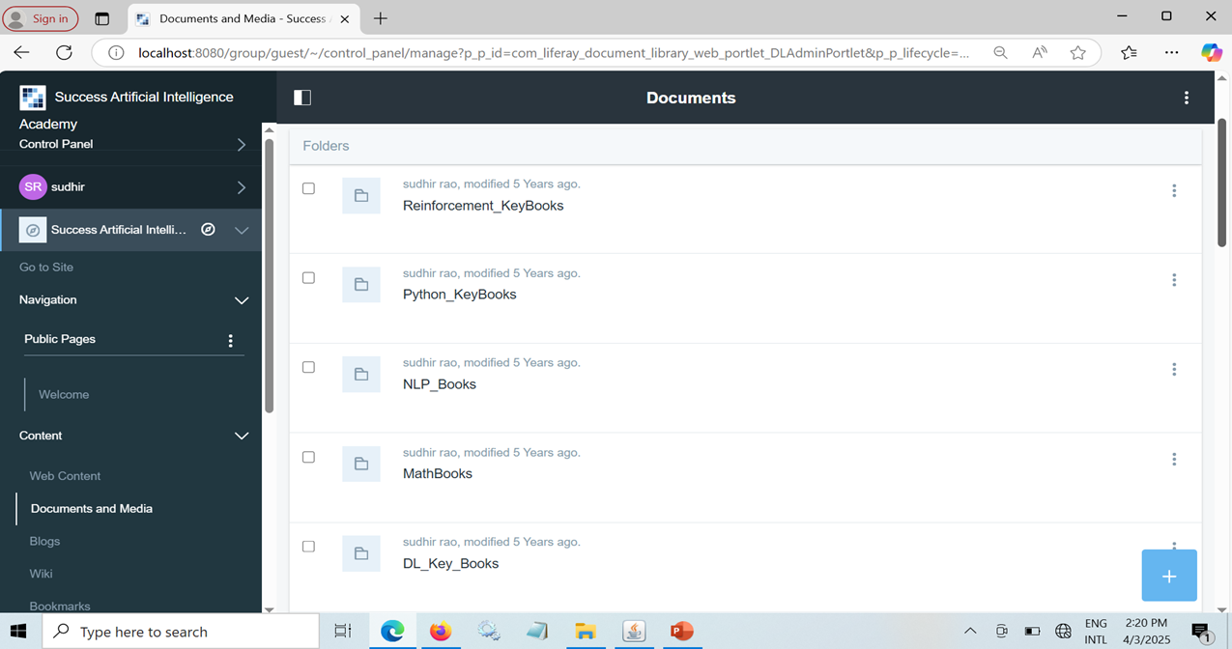
AFTER CLICKING DOCUMENTS IT SHOULD TAKE TO Documents Folders

Slide 5
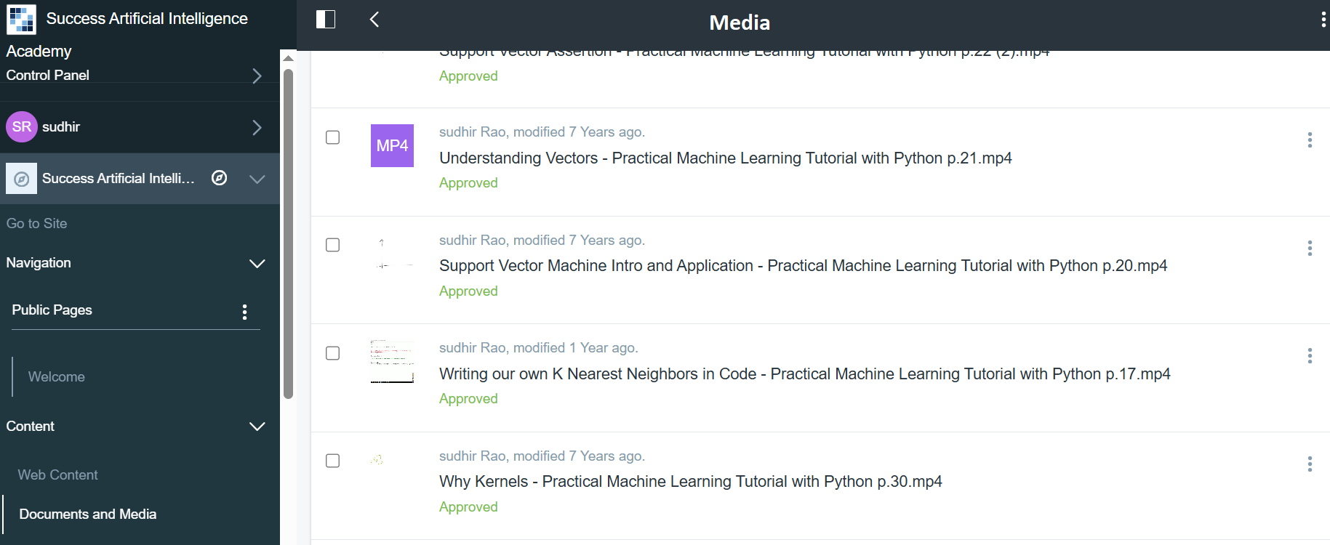
AFTER CLICKING Media IT SHOULD TAKE TO Media Folders

